Slide 1
Calculus
Functions and Tangent Lines

Slide 2
Outline
Functions and Their Shapes
The Slope of a Line
Tangent Lines

Slide 3



Functions and Their Shapes
A function is a mathematical rule that operates on an input to produce an output.
$$f\left(x\right)=x+3$$
$$f\left(x\right)=x^{2}$$
$$f\left(x\right)=x^{2}+x$$
Input: x | Output: f(x)
-1 | 2
0 | 3
0.5 | 3.5
2 | 5
Input: x | Output: f(x)
-1 | 1
0 | 0
0.5 | 0.25
2 | 4
Input: x | Output: f(x)
-1 | 0
0 | 0
0.5 | 0.75
2 | 6

Slide 4
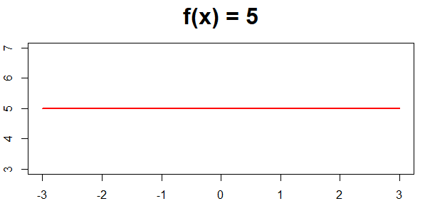
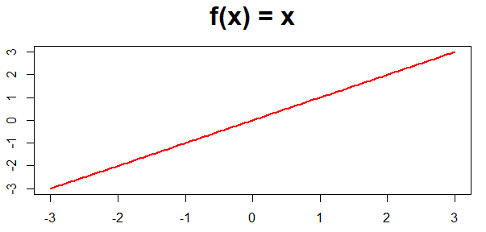
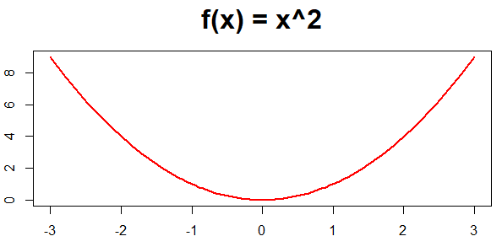
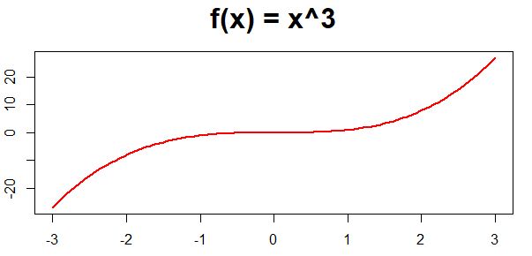
Functions and Their Shapes

Slide 5
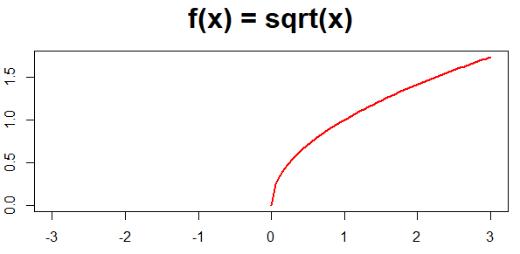
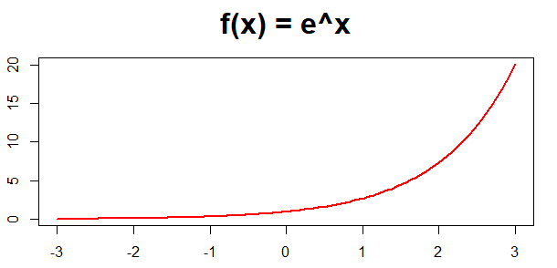
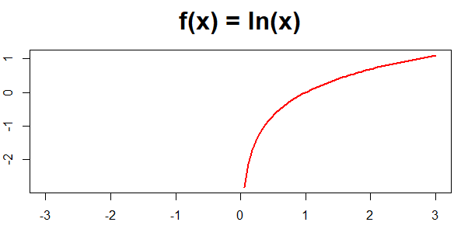
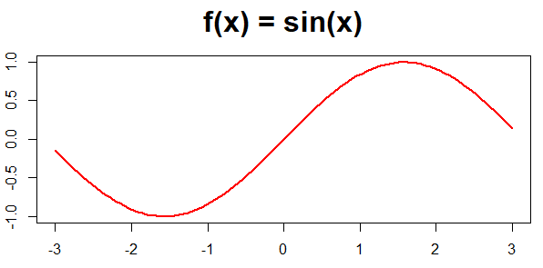
Functions and Their Shapes

Slide 6
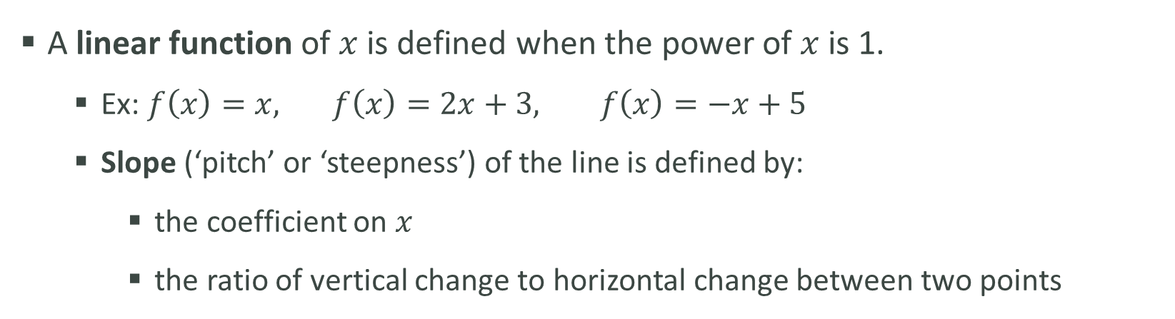
The Slope of a Line
A linear function of $x$ is defined when the power of $x$ is 1.
Ex: $f\left(x\right)=x, f\left(x\right)=2x+3, f\left(x\right)=−x+5$
Slope (‘pitch’ or ‘steepness’) of the line is defined by:
the coefficient on $x$
the ratio of vertical change to horizontal change between two points

Slide 7
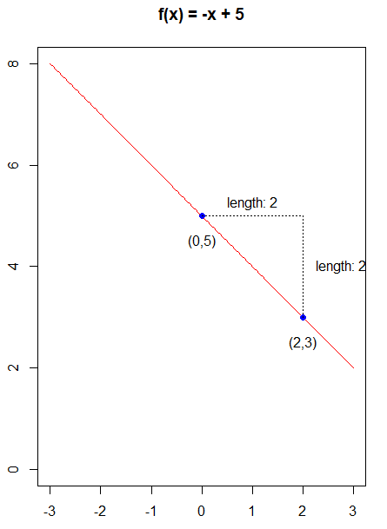
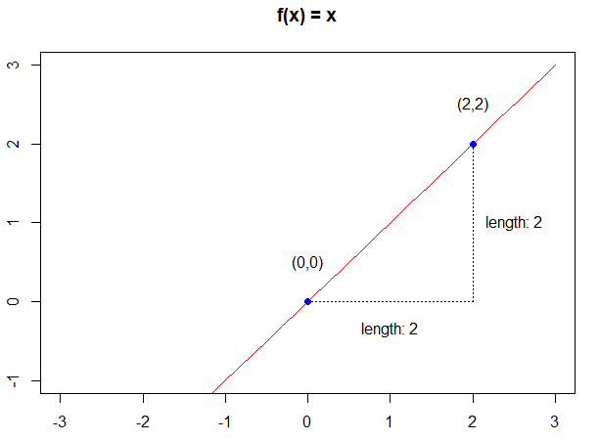
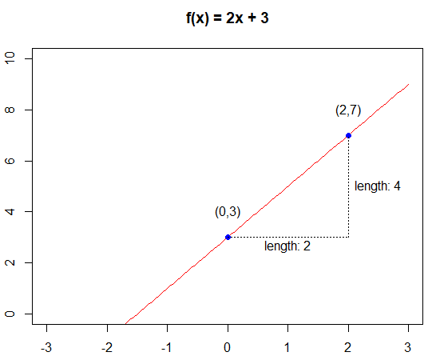
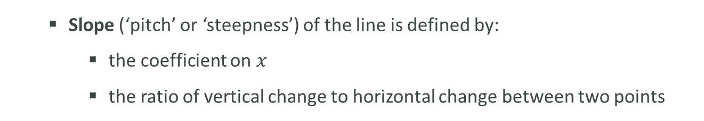
The Slope of a Line
Slope (‘pitch’ or ‘steepness’) of the line is defined by:
the coefficient on $x$
the ratio of vertical change to horizontal change between two points
Slope = 2/2 = 1
Slope = 4/2 = 2
Slope = -2/2 = -1

Slide 8
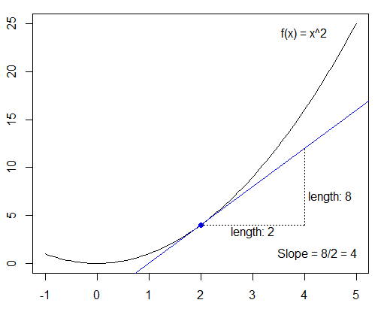
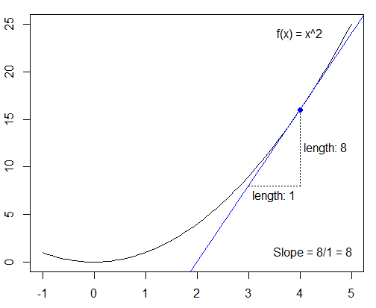
Tangent Lines
Tangent lines are lines who intersect a curve in exactly one point.
The slopes of a tangent line at a given point tells us the rate of change of the function at that point.

Slide 9
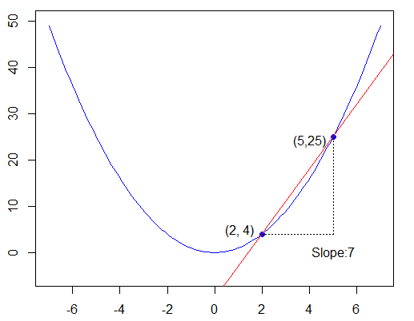
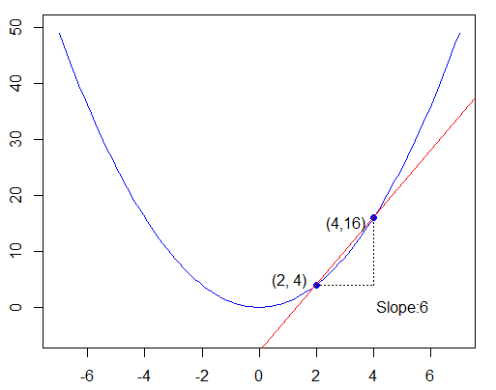
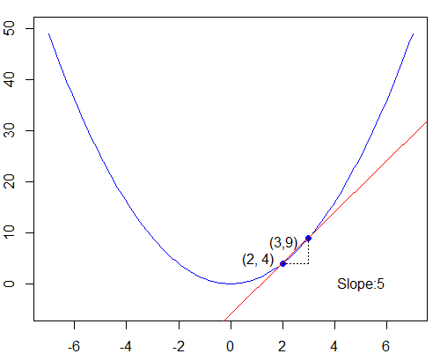
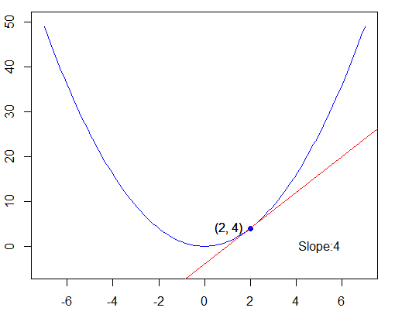
Tangent Lines
We can estimate the slope of a tangent line by using secant lines

